Slide 1
Employee Data Analysis using Excel
STUDENT NAME:
REGISTER NO :
DEPARTMENT :
COLLEGE :
Janani A
312203319
Commerce
Prince Shri Venkateshwara Arts And Science College

Slide 2
PROJECT TITLE
Employee Performance Analysis using Excel

Slide 3


AGENDA
Problem Statement
Project Overview
End Users
Our Solution and Proposition
Dataset Description
Modelling Approach
Results and Discussion
Conclusion
3/21/2024 Annual Review

Slide 4

PROBLEM STATEMENT
The significant challenges in effectively analyzing this data to evaluate employee performance comprehensively. The current dataset is underutilized due to its complexity, making it difficult to identify high performers, pinpoint areas needing improvement, and detect patterns that could inform management decisions. We need to develop an efficient method for analyzing this data in Excel to generate actionable insights, enhance employee productivity, and support data-driven HR strategies..

Slide 5

PROJECT OVERVIEW
The project aims to convert a large, complex Excel dataset containing detailed employee information into actionable insights that can enhance decision-making within the organization. The core of the project involves developing a weighted performance scoring model that evaluates employees across key metrics such as sales achievements, customer satisfaction, project completion, attendance, peer reviews, and manager feedback. This analysis will allow us to identify top performers, recognize underperformers, and uncover trends across departments and over time.

Slide 6
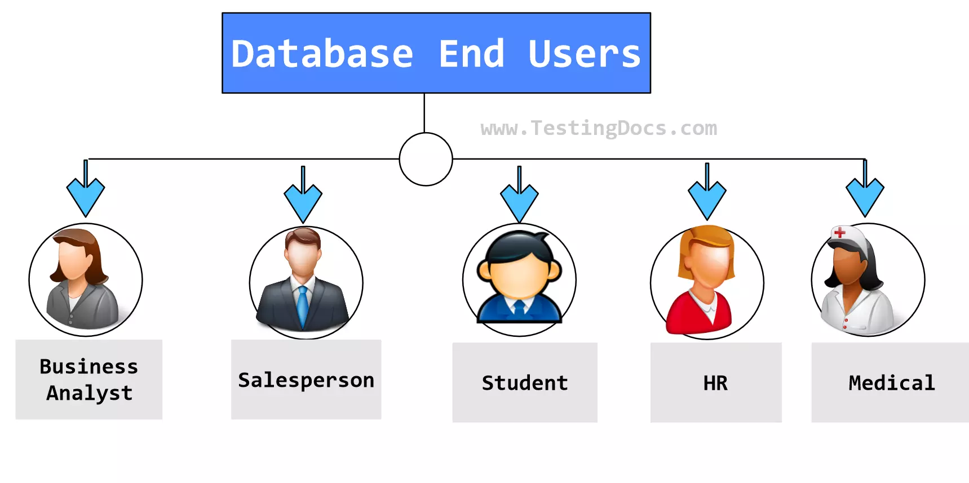

WHO ARE THE END USERS?
Employer
Employee
Organisation

Slide 7

OUR SOLUTION AND ITS VALUE PROPOSITION
Conditional Formatting – Missing Filter – Remove Formulae – Performance Pivot – Summary Gragh – Data Visualization

Slide 8
Dataset Description
Employee dataset – Kaggle 26 Features Employee ID - DE5B5E0E921696191474813EBC227A6F Name – Text Performance Level – Very High , High , Medium , Low Gender – Male , Female Employee Ratings

Slide 9
MODELLING
Data collection :
1). Department 2). Division 3). Job Function 4). Employee Classification
DATA CLEANING :
1). Start date 2). End date
PERFORMANCE LEVEL :
1). Very high 2). High 3). Medium 4). Low
9

Slide 10
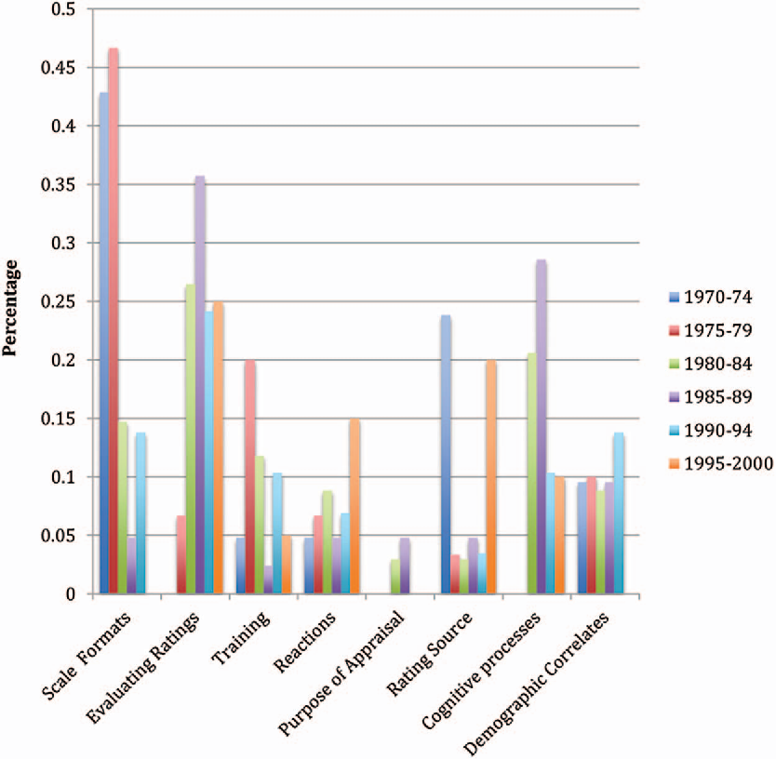
RESULTS
10

Slide 11
conclusion
The analysis of the employee performance dataset has provided valuable insights into various aspects of productivity, performance, and development within the organization. Key findings include the identification of top performers, who consistently excel across multiple metrics such as sales achievements and customer satisfaction. Recognizing and rewarding these individuals will help maintain their high levels of motivation and engagement. Conversely, the analysis has also highlighted underperformers who exhibit lower scores in areas such as attendance and peer reviews. Implementing targeted improvement plans and providing additional support for these employees can help address performance issues.

